Slide 1

Building a Multi-Tenant E-Commerce Marketplace
Welcome to an in-depth exploration of architecting a robust and scalable multi-tenant e-commerce marketplace. This presentation delves into the intricate challenges and sophisticated solutions required to build a platform that empowers numerous sellers while providing a seamless, personalised experience for buyers.

Slide 2

The Marketplace Vision: Core Features and Challenges
Multi-Tenant Storefronts
Seamless Transactions
Individual seller storefronts, each with unique branding and product listings.
Integrated shopping carts, secure checkout processes, and diverse payment options.
Personalised Discovery
Seller Empowerment
Intelligent search and recommendation engines tailored to individual user preferences.
Comprehensive dashboards for inventory, orders, and performance analytics.
The core of our marketplace includes sophisticated catalog and inventory management, robust cart and checkout flows, secure payment processing, efficient order orchestration, customer reviews, and intuitive seller dashboards. These functionalities are foundational to a thriving e-commerce ecosystem.

Slide 3

Architectural Foundations: Design Principles
Strategic Design Choices
Domain-Driven Microservices: Decomposing the system into small, independent services aligned with business domains (e.g., product, order, payment) to ensure agility and scalability.
Event Choreography: Implementing asynchronous event-driven communication for critical workflows like order processing and inventory updates, enhancing resilience and decoupling services.
API Gateway: Providing a single entry point for all client requests, handling routing, authentication, and rate limiting to streamline API management.
Content Delivery Network (CDN): Leveraging a CDN for static assets to reduce latency and improve load times for users globally.
Our architectural strategy prioritises a domain-driven microservices approach, fostering independent development and deployment. Event choreography ensures seamless data flow, while an API Gateway provides a unified and secure interface. A CDN optimises content delivery, crucial for a global marketplace.

Slide 4
Data Management & Non-Functional Goals
Relational Databases
Document Stores
For ACID-compliant transactions such as orders and payments, ensuring data integrity.
For flexible schema data like product catalogs, allowing for rapid evolution.
Search Indexing
Caching with Redis
Utilising Elasticsearch for powerful, fast, and scalable search capabilities.
Implementing Redis for high-speed data retrieval and session management.
Our non-functional goals are paramount: elastic scalability to handle traffic spikes, strong consistency for financial transactions, and robust protection of Personally Identifiable Information (PII). We select data stores based on their optimal fit for specific data types and access patterns.

Slide 5
Strategic Design Patterns for Robustness
Saga Pattern
Manages complex distributed transactions, like the order lifecycle, ensuring data consistency across multiple services.
Outbox Pattern
Ensures reliable message publishing by storing outgoing messages in the same transaction as state changes.
Factory Pattern
Abstracts the creation of objects, such as different payment provider integrations, promoting flexibility and extensibility.
Adapter Pattern
Allows incompatible interfaces to work together, crucial for integrating various fulfillment partners.
Facade Pattern
Provides a simplified interface to a complex subsystem, making operations like search more accessible to consumers.
These design patterns are instrumental in building a resilient, maintainable, and extensible platform. They address common challenges in distributed systems, from transaction management to external service integration.

Slide 6
Security and Reliability: Our Paramount Concerns
Security isn't just a feature; it's the foundation of trust in any marketplace.
PCI-Aware Design: Strict adherence to Payment Card Industry Data Security Standard (PCI DSS) for all payment processing components.
JWT & Secret Rotation: Implementing JSON Web Tokens for secure authentication and regular rotation of API keys and secrets.
Web Application Firewall (WAF): Protecting against common web exploits and malicious traffic.
Canary Releases: Gradual rollout of new features to a small subset of users to minimise risk.
Disaster Recovery: Defining clear Recovery Point Objectives (RPO) and Recovery Time Objectives (RTO) to ensure business continuity.
Protecting sensitive customer data and ensuring continuous availability are non-negotiable. Our approach integrates security and reliability from design to deployment, mitigating risks and maintaining operational integrity.

Slide 7

Architectural Documentation: A Comprehensive Requirements Pack
Key Deliverables
Stakeholder Analysis: Identifying all key players and their needs.
User Stories: Detailed narratives from the perspective of different user types (buyers, sellers, admins).
Context & Use-Case Diagrams: Visual representations of system boundaries and interactions.
Constraints & Assumptions: Documenting technical, business, and operational limitations and premises.
A well-defined requirements pack is crucial for guiding development and ensuring alignment across all teams. It provides a single source of truth for understanding the system's purpose, functionality, and operational context.

Slide 8






Deep Dive: Database Design and Performance Engineering
ERD & Schema
Normalisation/Denormalisation
Entity-Relationship Diagrams and detailed schema definitions for all data stores.
Rationale for chosen levels of data normalisation, balancing integrity and query performance.
Load Balancing
Indexing Strategies
Implementing effective load balancing strategies to distribute traffic and prevent bottlenecks.
Optimised indexing to accelerate common queries and improve database efficiency.
Caching Mechanisms
Partitioning/Sharding
Utilising in-memory caches and CDNs to reduce database load and improve response times.
Strategies for distributing data across multiple nodes to enhance scalability and fault tolerance.
Optimising database design and performance is critical for a high-traffic e-commerce platform. Our approach focuses on smart schema design, strategic indexing, and advanced scaling techniques like sharding and caching.

Slide 9
API Specification and Observability
API Endpoints
Clearly defined REST/gRPC endpoints, including paths, methods, and error codes.
Idempotency
Ensuring that repeated requests have the same effect as a single request, crucial for payment processing.
Versioning
Strategy for API versioning to allow for backward compatibility and smooth evolution.
Logs, Metrics, Traces
Comprehensive logging, metrics collection, and distributed tracing for full system visibility.
SLOs/SLIs
Defining Service Level Objectives and Indicators to measure performance and reliability.
Alerting Runbook
Automated alerts and detailed runbooks for rapid incident response and resolution.
A meticulously documented API specification ensures seamless integration for all consumers, while robust observability tools provide the insights needed to monitor, troubleshoot, and maintain the system's health and performance.

Slide 10
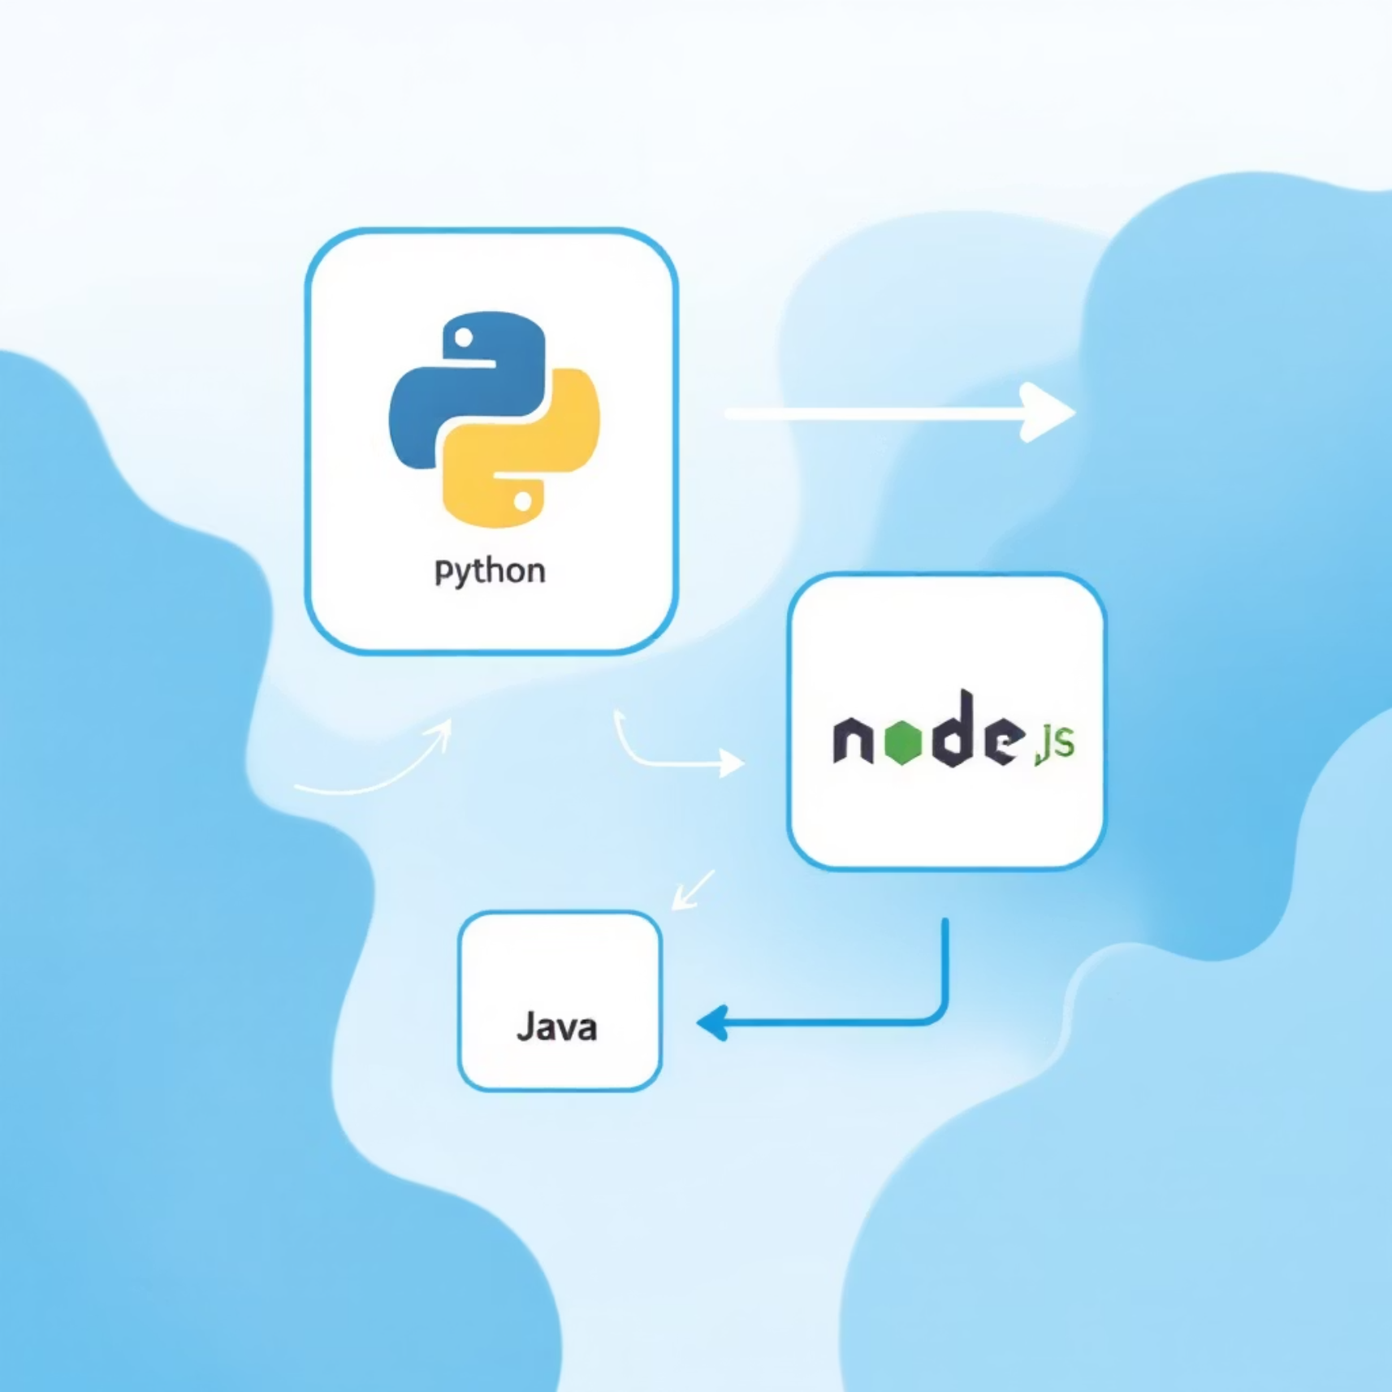
Tech Stack Justification: Informed Choices
Comparative Analysis
Tier-by-Tier Evaluation: Comparing 2-3 leading options for each architectural tier (e.g., programming languages, frameworks, cloud providers, databases).
Trade-off Documentation: Clearly articulating the pros and cons of each option, considering factors like performance, cost, community support, and ease of maintenance.
Alignment with Goals: Ensuring chosen technologies align with our non-functional requirements and long-term vision.
Selecting the right technology stack is paramount. Our justification process involves rigorous evaluation and transparent documentation of trade-offs, ensuring that every technical decision supports the marketplace's strategic objectives and future growth.

